Slide 1

ARTIFICAL INTELLIGENCE
BATCH - 17

Slide 2
BATCH - 17
SHANMUKHA SUDHA KIRAN.T– 211FA04003
RAVIKIRAN.K – 211FA04043
DEEPTHI.U– 211FA04046
SAHILRAJ– 211FA04677
SEC –A , 3rd B. TECH
Dept.CSE

Slide 3
Table of Contents
01
02
03
04
Aim
PROBLEM STATEMENT
INTRODUCTION
ALGORITHM
SOURCE CODE
TEST CASE
RESULT
CONCLUSION
05

Slide 4
AIM
This paper presents a comprehensive analysis of the application of the Alpha-Beta pruning algorithm in the context of a Tic-Tac-Toe game-playing AI. The primary objective is to evaluate and compare the performance of Alpha-Beta pruning against the conventional Min-Max algorithm in terms of computational efficiency and the ability to identify optimal game moves.

Slide 5
Problem statement:
The Alpha-Beta pruning algorithm in a specific game scenario and compare its performance with the Min-Max algorithm.
a. Explain the evaluation function used to assign scores to game states and how it influences the search process.
b. Explore possible extensions or variations of Alpha-Beta pruning that could further improve its efficiency or accuracy.
c. Consider a game of Tic-Tac-Toe where the AI algorithm uses Alpha-Beta pruning.
The game tree is represented by a search tree with each node representing a possible game state. The AI's objective is to find the optimal move by searching the game tree. You can illustrate the application of Alpha-Beta pruning by showing the pruning process at each level of the search tree. Demonstrate how the algorithm eliminates certain branches of the tree based on the calculated alpha and beta values, effectively reducing the number of nodes explored.By comparing the number of nodes explored with and without Alpha-Beta pruning, you can showcase the efficiency improvement achieved by the algorithm

Slide 6

Introduction
Min-Max algorithm: Mini-max is a kind of backtracking algorithm that is used in decision making and game theory to find the optimal move for a player, assuming that your opponent also plays optimally. It is widely used in two player turn-based games such as Tic-tac-toe, Backgammon, Mancala, Chess, etc.
Alpha-Beta pruning: It is a method that optimizes the Minimax algorithm. The number of states to be visited by the minimax algorithm are exponential, which shoots up the time complexity. Some of the branches of the decision tree are useless, and the same result can be achieved if they were never visited.

Slide 7
Algorithm
1)Start
2)Import the math module to use mathematical functions.
3)Define constants for representing empty cells, player X, and player O.
4)Create the game board as a list of 9 empty cells.
5)Define a function print_board(board) to print the current state of the game board.
6)Define a function check_winner(board) to check if there is a winner or if the game is a tie.
7)Define a function evaluate(board) to evaluate the current state of the board and return a score for the minimax algorithm.
8)Define the minimax(board, depth, alpha, beta, maximizing_player) function that implements the minimax algorithm with alpha-beta pruning. This function recursively explores possible game states. 9)Define a function find_best_move(board) that uses the minimax algorithm to find the best move for the AI player (X).
10)Implement the main game loop, which continues until there's a winner or a tie.
11)Inside the main game loop, print the current game board.
12)Check if there's a winner or a tie. If so, print the result and exit the loop.
13)If the game is still ongoing, determine whose turn it is (X or O) based on the number of moves made. 14)If it's O's turn, prompt the human player for input and update the board. If it's X's turn, use the find_best_move function to make the AI move and update the board.
15)Print the result.
16)stop

Slide 8
Source Code
import math
# Constants for representing the players and empty cells
EMPTY = "-"
PLAYER_X = "X"
PLAYER_O = "O"
# The game board
board = [EMPTY, EMPTY, EMPTY,
EMPTY, EMPTY, EMPTY,
EMPTY, EMPTY, EMPTY]
# Function to print the game board
def print_board(board):
print("---------")
for i in range(3):
print("|", board[i*3], "|", board[i*3 + 1], "|", board[i*3 + 2], "|")
print("---------")
# Function to check if a player has won
def check_winner(board):
winning_combinations = [
[0, 1, 2], [3, 4, 5], [6, 7, 8], # rows
[0, 3, 6], [1, 4, 7], [2, 5, 8], # columns
[0, 4, 8], [2, 4, 6] # diagonals
]
# Minimax function with alpha-beta pruning
def minimax(board, depth, alpha, beta, maximizing_player):
if check_winner(board) is not None or depth == 0:
return evaluate(board)
if maximizing_player:
max_eval = -math.inf
eval_score = minimax(board, depth - 1, alpha, beta, False)
board[i] = EMPTY
max_eval = max(max_eval, eval_score)
alpha = max(alpha, eval_score)
if beta <= alpha:
break
return max_eval
for combination in winning_combinations:
if board[combination[0]] == board[combination[1]] == board[combination[2]] != EMPTY:
return board[combination[0]]
if EMPTY not in board:
return "tie"
return None
# Function to evaluate the game board
def evaluate(board):
winner = check_winner(board)
if winner == PLAYER_X:
return 1
elif winner == PLAYER_O:
return -1
else:
return 0

Slide 9
# Function to find the best move using minimax with alpha-beta pruning
def find_best_move(board):
best_score = -math.inf
best_move = None
for i in range(9):
if board[i] == EMPTY:
board[i] = PLAYER_X
move_score = minimax(board, 9, -math.inf, math.
if move_score > best_score:
best_score = move_score
best_move = i
return best_move
# Main game loop
while True:
print_board(board)
winner = check_winner(board)
if winner is not None:
if winner == "tie":
print("It's a tie!")
else:
print("Player", winner, "wins!")
break
if len([cell for cell in board if cell != EMPTY]) % 2 == 0:
while True:
move = int(input("Enter O's move (0-8): "))
if board[move] == EMPTY:
board[move] = PLAYER_O
break
else:
print("Invalid move! Try again.")
else:
move = find_best_move(board)
board[move] = PLAYER_X

Slide 10
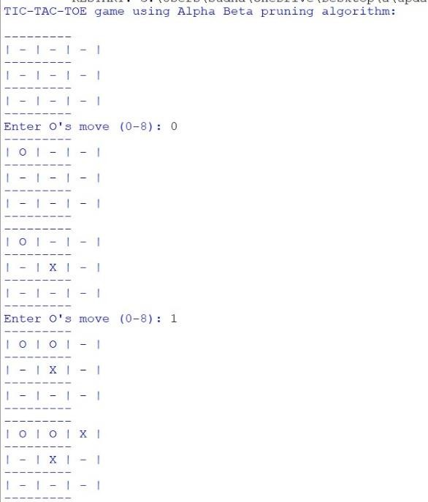
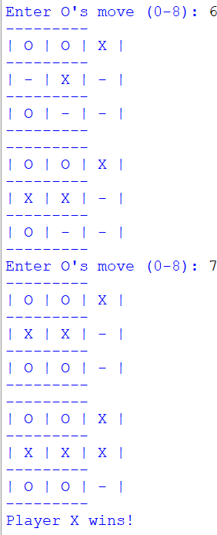
TEST CASE:
AI vs Human
Player O: Human
Player X:AI

Slide 11
Our experimental results show that Alpha-Beta pruning significantly reduces the number of nodes explored during the search, leading to faster decision-making compared to the Min-Max algorithm. This performance improvement becomes more pronounced as the depth of the game tree increases.
RESULT:

Slide 12

Conclusion
In the context of playing Tic-TacToe, the Alpha-Beta pruning algorithm demonstrates its effectiveness in reducing computational complexity while maintaining competitive gameplay. It outperforms the traditional Min-Max algorithm in terms of computational efficiency. This research contributes to the broader field of game AI and showcases the practical advantages of Alpha-Beta pruning, especially when applied to games with complex state spaces.

Slide 13
Thank You
BATCH - 17

